Slide 1
ctcLink
Student Pages
Example from
Lower Columbia College

Slide 2
Student Homepage
Login to ctcLink
Select Student Homepage

Slide 3
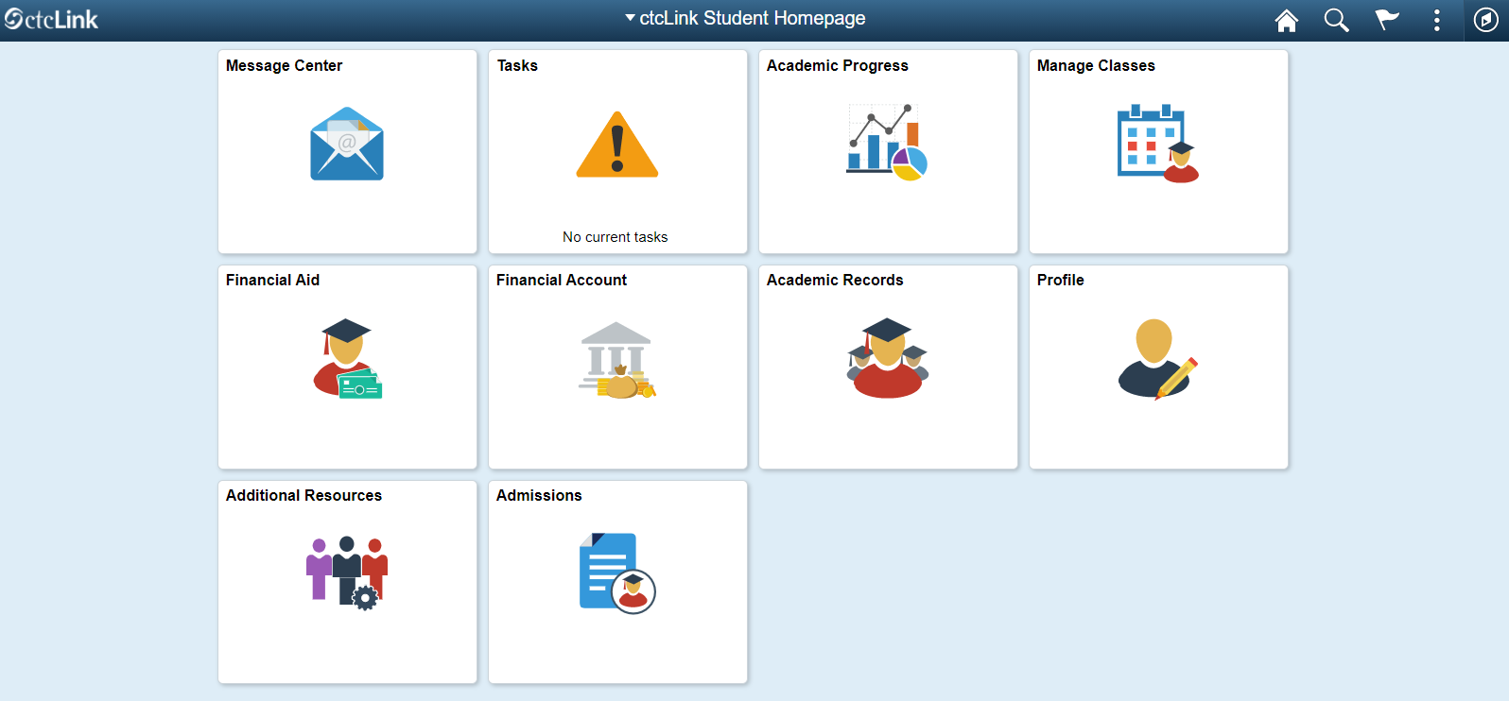
Student homepage

Slide 4
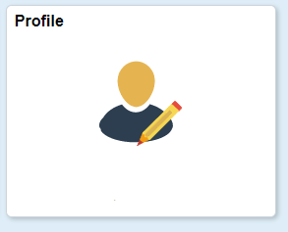
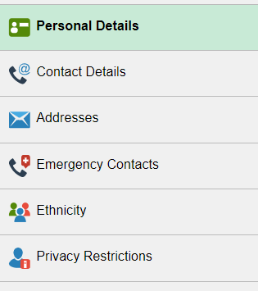
Profile
The screen will open up with your personal details such as Name, birthdate, and gender.
You cannot change any of the personal details.

Slide 5
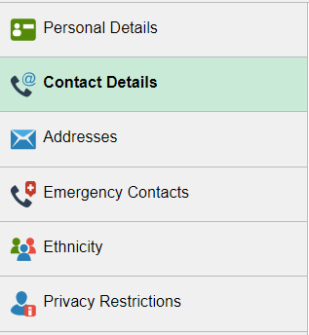
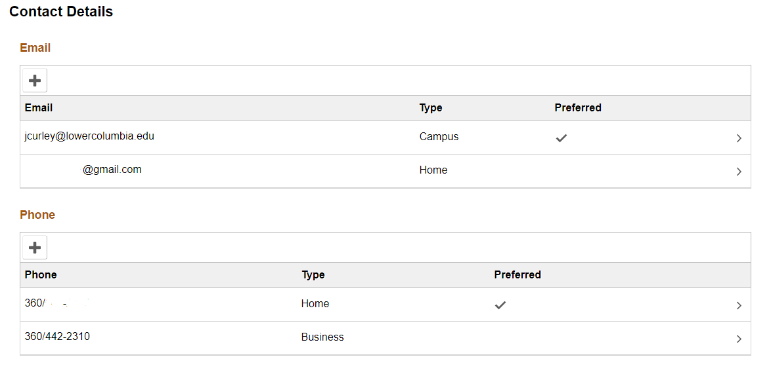
Contact Details – Editing

Slide 6
Contact Details – Adding

Slide 7
Contact Details - Preferred

Slide 8
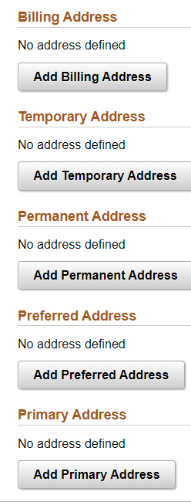
Addresses - Types

Slide 9
Addresses - Editing

Slide 10
Addresses - Adding

Slide 11
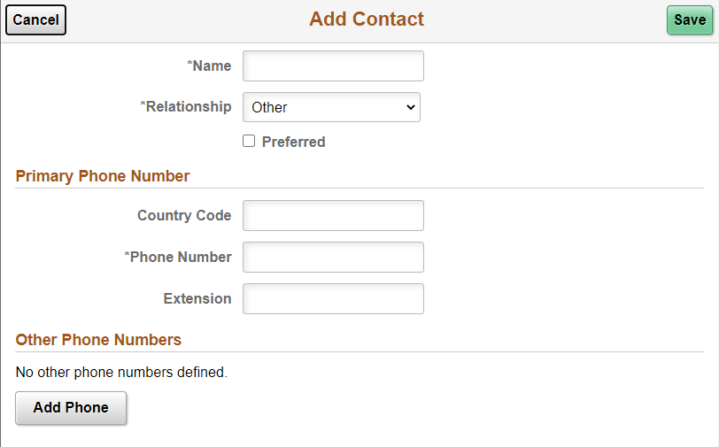
Emergency Contacts

Slide 12
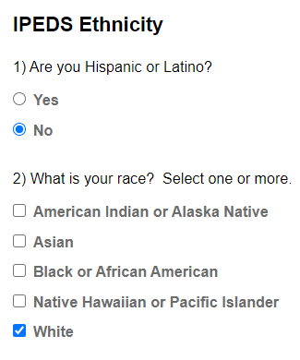
Ethnicity

Slide 13
Privacy Restrictions
Do Not Change!

Slide 14
Student Homepage

Slide 15
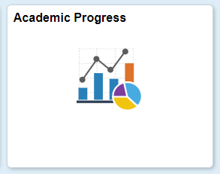
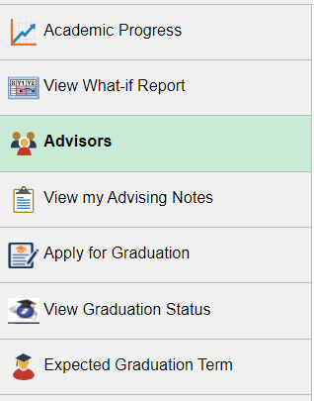
Academic Progress
This is where you can see your advisor.
You will have more than one advisor.

Slide 16
Student Homepage

Slide 17
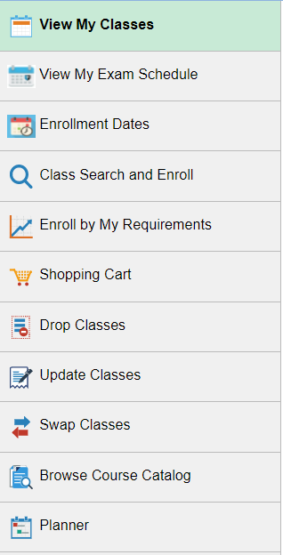
Manage Classes

Slide 18
View My Classes
You will click on the quarter you want to view.
Click on Printer View it is easier to read.

Slide 19
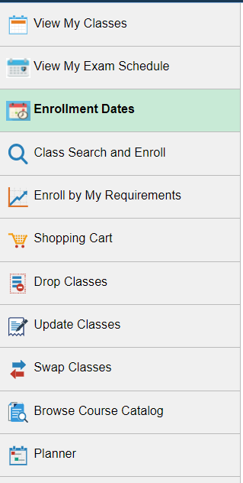
Enrollment Dates
You will be able to view your enrollment dates here.
This is the date and time you are allowed to start enrolling in classes.
This is different for every student.
You will have a range for priority enrollment.
You can still enroll after this date it just will be during open enrollment time.

Slide 20
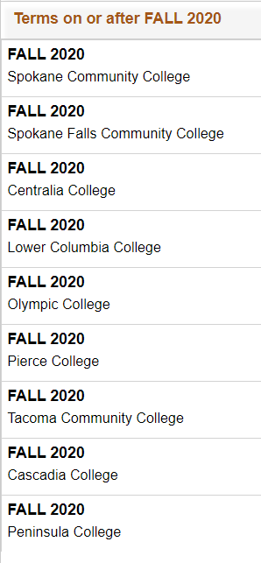
Class Search and Enroll
This is where you register for classes.
First you must select the correct college.

Slide 21
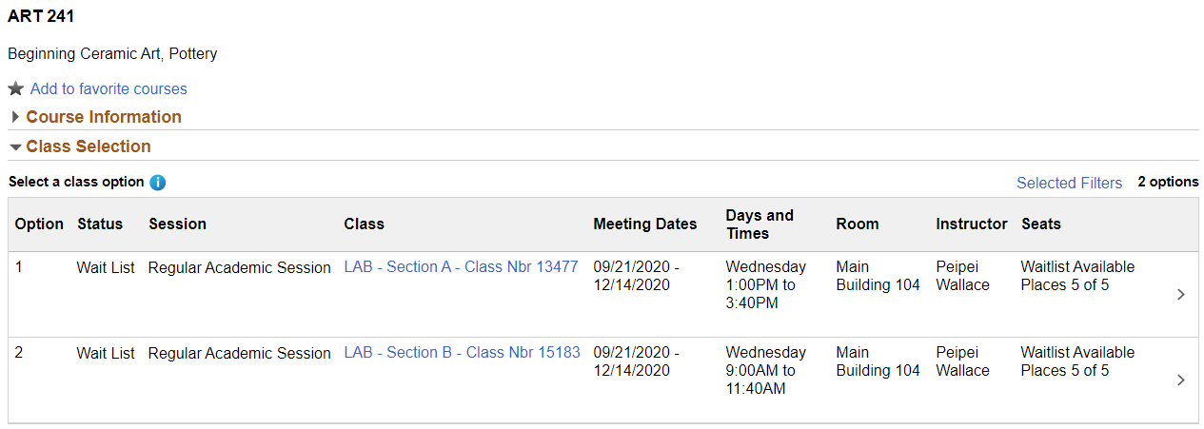
Steps to select a class
Search for a class.
The more general the search the better.
Select the class you want from the list. (Art 241)
Select the section you want by using the right arrow

Slide 22
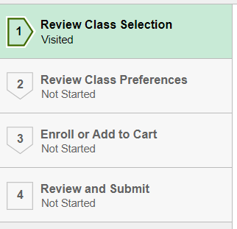
The Four Steps
Review Class Selection then click NEXT in the right-hand corner.
Review Class Preferences then click ACCEPT in the right-hand corner.
This is where you will add a permission number if you need one.
Enroll or Add to Cart. Make a selection and click NEXT.
If it is not your time to register yet you will only be able to select Add to Cart.
Review and Submit. Click SUBMIT in the upper right had corner.
Pro Tip: This process is very slow. If you do not see the next, accept, or submit buttons, wait to see if they appear. It just takes time.

Slide 23
Student Homepage

Slide 24
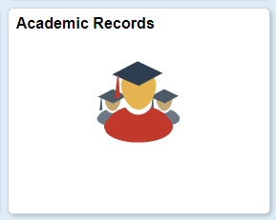
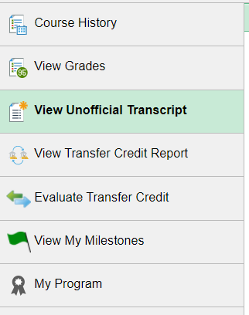
Academic Records
This is where you will view your unofficial transcript.

Slide 25
View Unofficial Transcript
2
1
4
3

Slide 26
Student Homepage

Slide 27
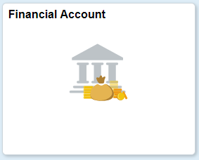
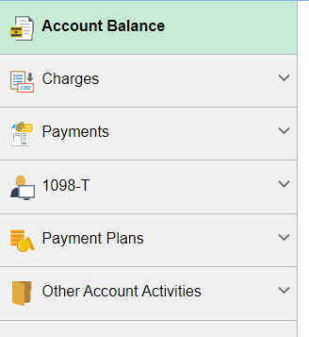
Financial Account
Where you see your account and pay for school.

Slide 28
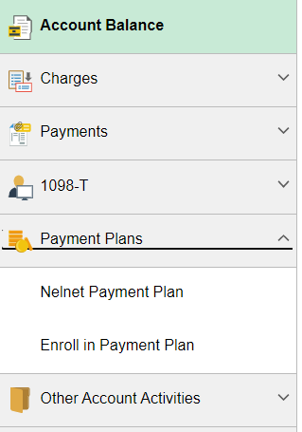
Ways to Pay
You can make payments in ctcLink or you can sign up for a payment plan.

Slide 29
Payment Issues when using ctcLink
When making a payment the address must be in correct USA format:
1931 Olympia Way #12 (The apartment number is last not first.)
Longview, WA 98632 (The state is WA and the zip code is 98632.)
Amounts over $4000 in ctcLink will not get posted to your account automatically.
This error will not fix itself
You need to email finance.
When making the payment the screen may go back to the beginning.
This means the payment was not accepted.
You will need to call cashiering to pay.

Slide 30
Student Homepage

Slide 31
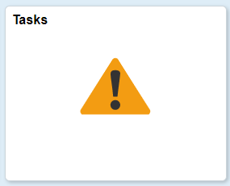
Tasks
Watch this tile for things you might need to do.
Let us know if you have any questions.

Slide 32
Student Homepage

