Slide 1
ctcLink
Student Pages - Mobile
Example from Lower Columbia College

Slide 2
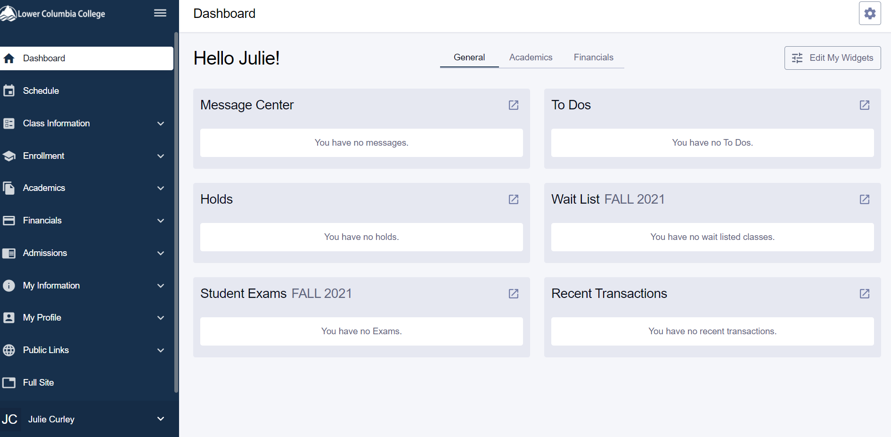
Student Dashboard

Slide 3
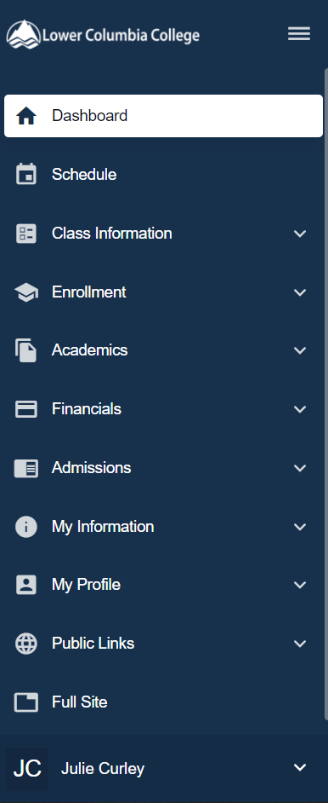
Navigation
Click on My Profile

Slide 4
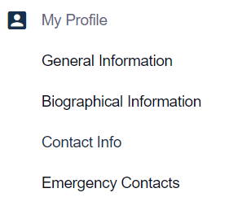
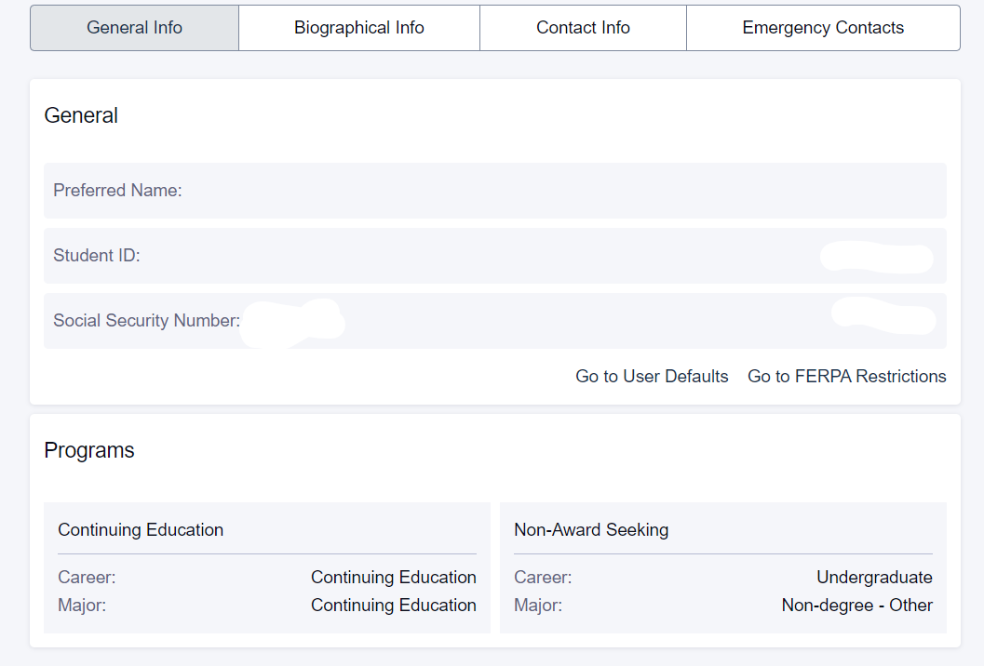
Profile: General Information
You cannot change the information on this tab.

Slide 5
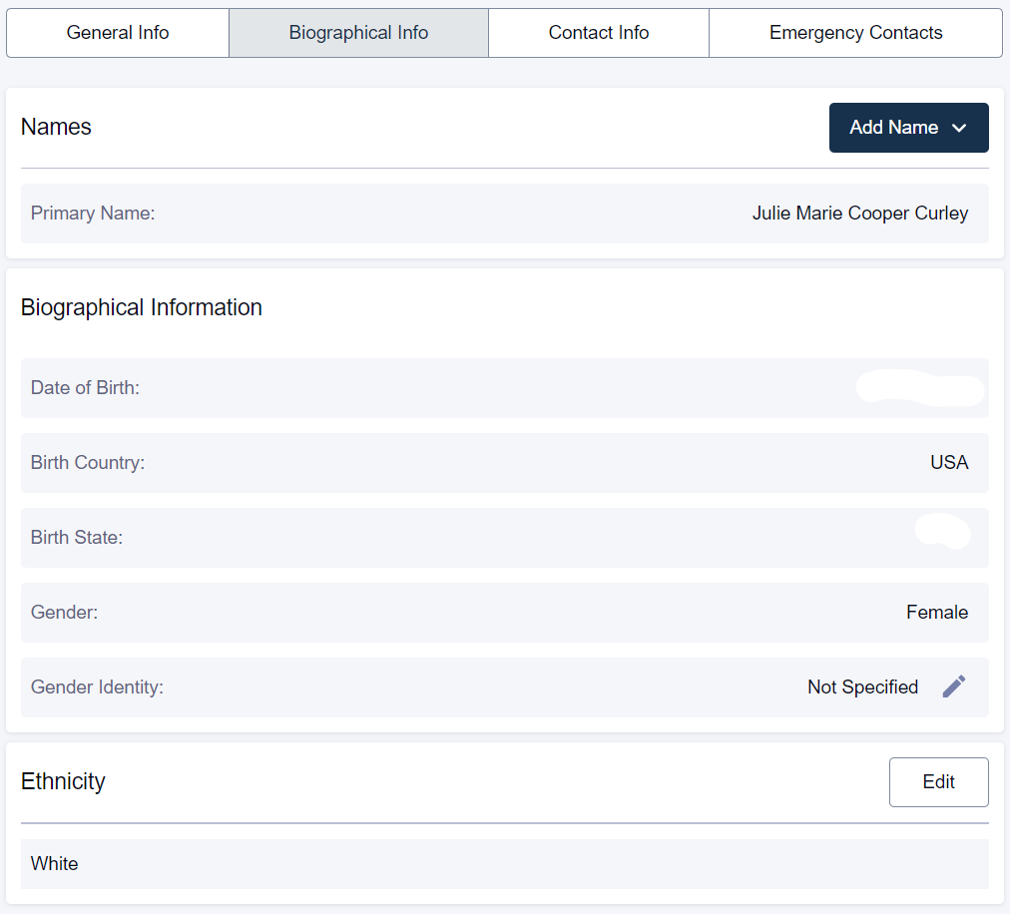
Profile: Biographical Information
You can add a preferred name
You can add your Ethnicity

Slide 6
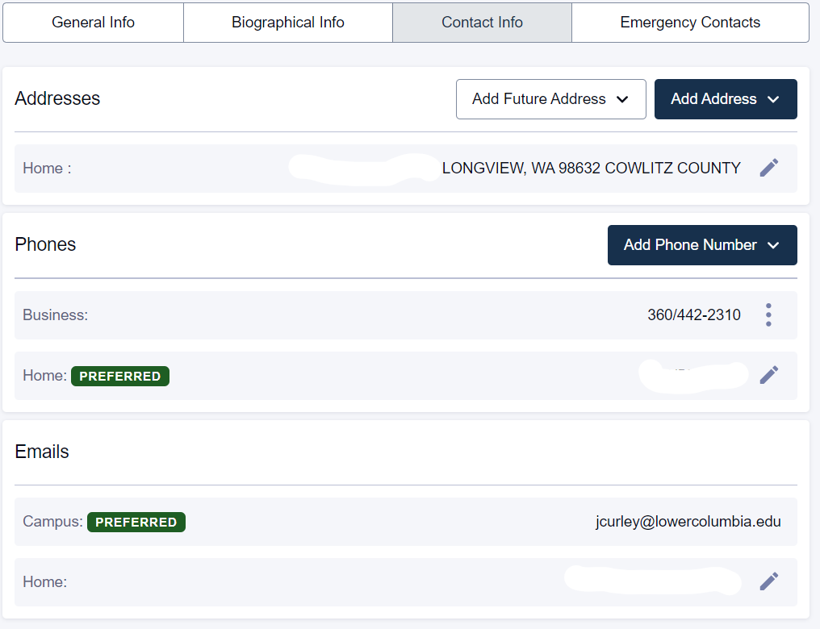
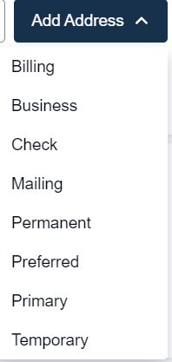
Profile: Contact Information
Edit address by clicking the pencil
Add address by selecting the drop down

Slide 7
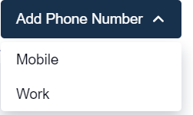
Profile: Contact Information
Edit phone number by clicking the pencil
Add phone number by selecting the drop down

Slide 8
Emergency Contacts

Slide 9
Navigation
Schedule: View your class schedule here
Class Information: View and register for class here
Enrollment: See enrollment date, shopping cart, wait lists, etc.
Academics: View unofficial transcript, Apply for graduation, see your transfer credits
Financials: see what you owe, and make a payment. – redirected

Slide 10
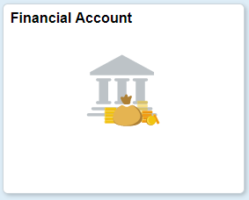
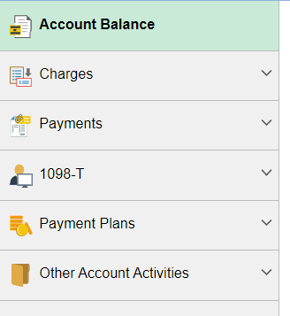
Financial Account
Where you see your account and pay for school.

Slide 11
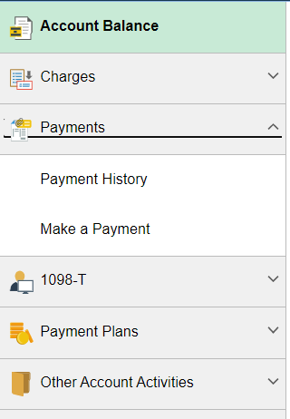
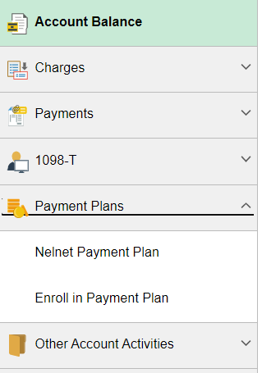
Three Ways to Pay

Slide 12
Payment Issues when using ctcLink
When making a payment the address must be in correct USA format:
1931 Olympia Way #12 (The apartment number is last not first.)
Longview, WA 98632 (The state is WA and the zip code is 98632.)
Amounts over $4000 in ctcLink will not get posted to your account automatically.
This error will not fix itself
You need to email finance and please copy us in.
When making the payment the screen may go back to the beginning.
This means the payment was not accepted.
You will need to call cashiering to pay.

Slide 13
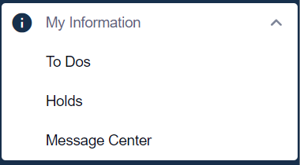
My Information
LCC International Students always have one “hold”.
It says you are an international student and must follow USCIS regulations.
Watch this for things you might need to do.
Let us know if you have any questions.

Slide 14
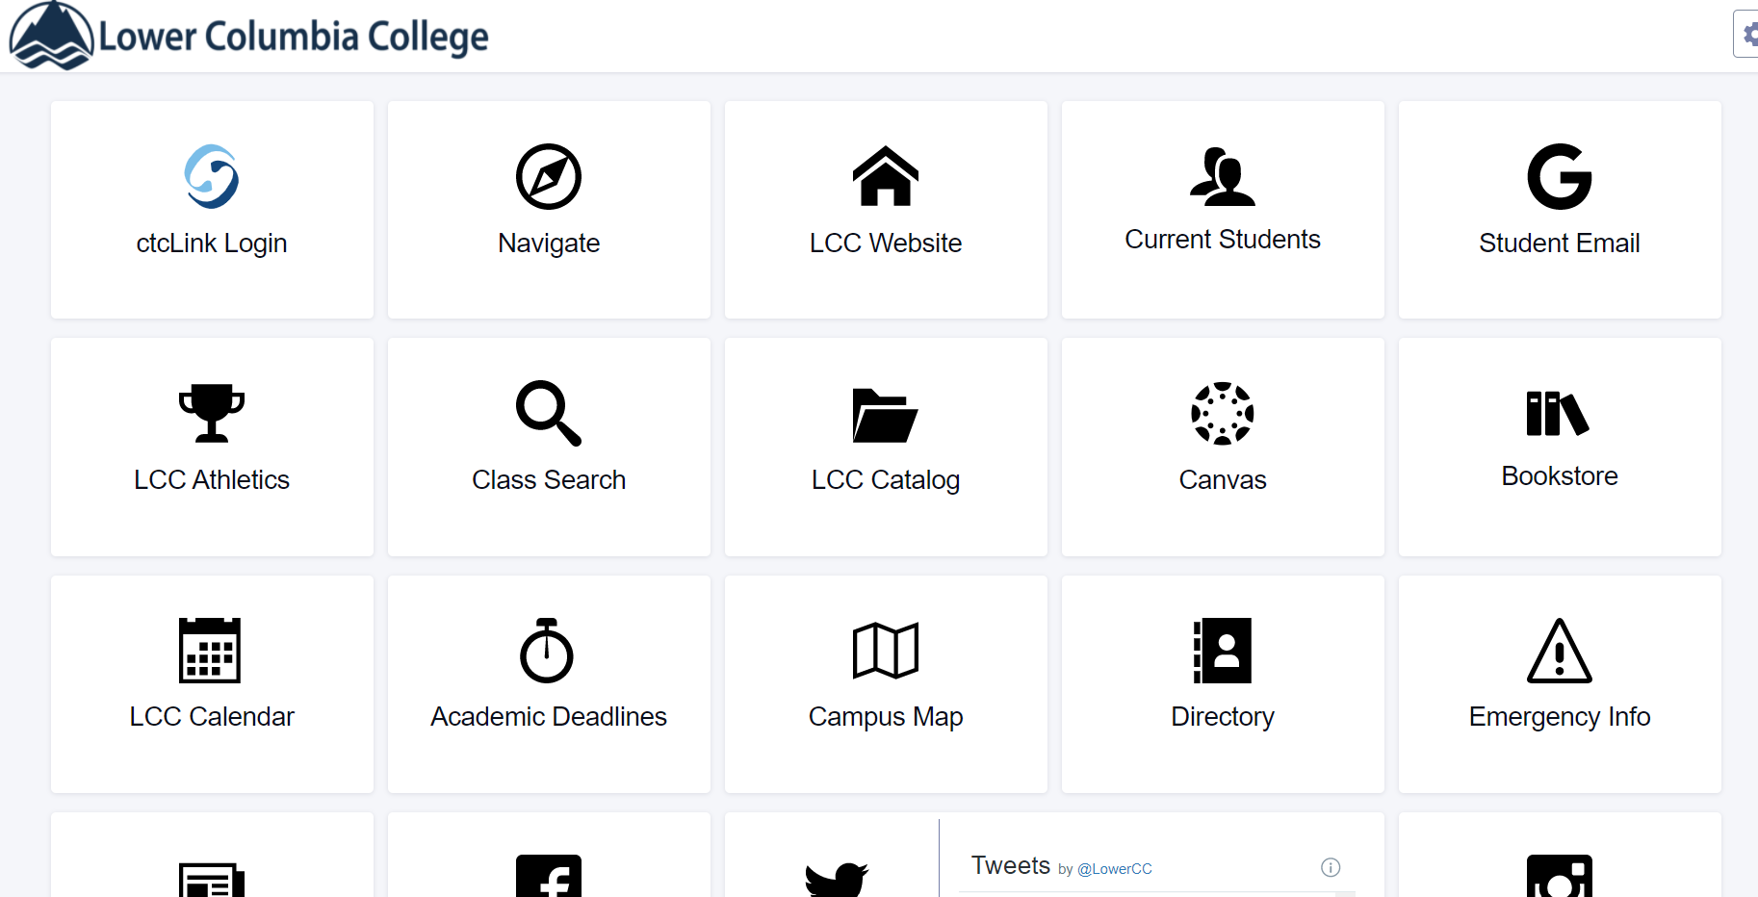
Student Homepage
You can go back to this page and get to Navigate, LCC Website, Student Email, Canvas, Campus map etc.
Do you remember how to get here?

