Slide 1
CtcLink Deployment Groups 5 & 6: Duck and Cover!
(and we promise you're going to survive!)

Slide 2
Introductions
Csendi Hopp
International Admissions Manager, Clark College
Gina Panattoni
Administrative Assistant, International Program, Seattle Colleges
Julie Curley
International Programs Specialist, Lower Columbia College
Lisa Lyman
Assistant Director of International Programs, Cascadia College
Marie Boisvert
Director, International Programs, Lower Columbia College
YonHee Fisher
Associate Director, Fiscal and Contracts Management, Edmonds College

Slide 3
Key Terms
Notes:
Julie (5 minutes for the section)

Slide 4
Ctclink Glossary
Go live vs go-live vs Go-Live
The first day a college begins to use ctcLink as its system of record
Verb. We are getting ready to go live on ctcLink PeopleSoft.
Noun. The web pages are being updated in time for Go-Live.
Adjective. The go-live preparations are underway.
Notes:
Julie

Slide 5
The three Pillars
Financial Management (FM)
Human Captial Management (HCM)
Campus Solutions (CS)
Each Pillar contains several modules.
Modules are a group of processes that are related to each other.
Notes:
Julie

Slide 6
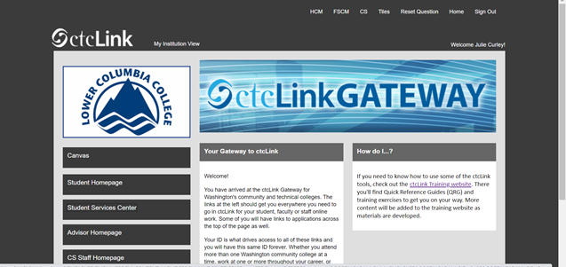
Home Page Terms
Nav Bar or
Navigation Bar
Tile
Notes:
Julie

Slide 7
Common terms
EMPLID - Student number or staff ID number
Service Indicators – A flag on a student account
Query - A report
Student Groups – A way to group students in different categories
Stacks – A way to keep historical data when changes are made
Roles – Type of work and a way to identify the function you need in ctcLink
Notes:
Julie

Slide 8
Preparing for Go-Live
Notes:
Marie (for breakout room)

Slide 9
“When fishermen cannot go to sea, they repair nets.” ― Nabil Sabio Azadi
Notes:
Register students
Print out student bills & records of student payments
Print out your budget and any financial reports
Pay agents / vendors ahead of time

Slide 10
GET A SEAT AT THE TABLE
Notes:
What other departments do you work with? Make sure you get a voice when decisions are being made about:
-Registration (processing apps)
-Payroll (hiring int'l students)
-Instruction (paying Intensive English / other faculty)
-Cashiering & billing (application fees, insurance fees)
-Housing (housing fees)
-Financial aid (scholarship / foundation awards to international students)

Slide 11
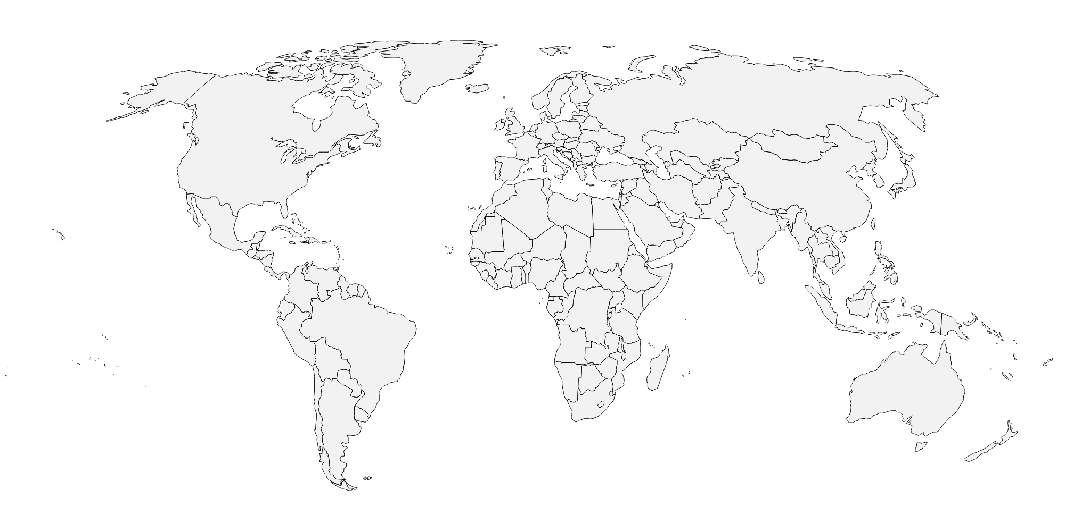
Map out your processes
Notes:
When & how are charges put on accounts?
-housing
-insurance
-tuition
-app fees
-"international fees"
What is your admission workflow?
-at what point do you enter applications into the system?
---what triggers that?
---who enters the information?
---Do you have any automated processes currently? (TOEFL/IELTS scores auto-uploads? 3rd party software?)
How and when do new and continuing students pay their bills?
How and when are students awarded scholarships?

Slide 12
Define rolls
Notes:
Who will be in charge of:
Processing and entering applications
Putting fees on accounts
Making updates to student records accounts
Tracking student financial accounts
Tracking scholarship awards and if they are awarded
-----
Try to get access to everything you can

Slide 13
MANAGE Expectations
Notes:
Students
Vendors
Staff

Slide 14
Post Go-Live
Tips & Lessons Learned
Notes:
Lisa (7-8 minutes for section)

Slide 15
Important Tasks post go-live
Testing
Training
Setting expectations
Notes:
Lisa

Slide 16
Testing
Test out and adapt your earlier plans about different processes.
Communicate with other offices to troubleshoot pain points.
Have all international program staff test out their daily/monthly/quarterly tasks in ctcLink and see what issues come up.
Notes:
Lisa
Key processes to test out early: admissions/application processing, matriculation/activation of new student records to prepare for class registration, test score or proficiency entry, student insurance, end of term processes (grade report, academic progress, etc), and main reports/queries you'll need to run.
Explore ctcLink and see where to find all the different information (see list of key pages in take home resources).

Slide 17
Training
A lot of initial difficulties in ctcLink come from the newness of ctcLink and a lack of training.
Advocate for all college staff (including international programs) to receive proper training.
Consider having your office meet weekly post Go-Live for ctcLink training and troubleshooting for at least one quarter.
Notes:
Lisa

Slide 18
Setting Expectations
There will be issues with the transition to ctcLink!
Encourage patience and help set reasonable expectations for:
Staff
Faculty
Students
Agents
Student insurance provider
Other external partners (especially for billing)
Notes:
Lisa
Some of the biggest issues relate to timely payment of invoices and difficulties viewing/confirming payments/transactions. Recommend for students to save all receipts of tuition payments (screenshots) for their own records.

Slide 19
Tips & Tricks
Notes:
Lisa: Some of the information on these slides may be ahead of where your office is right now is preparing for ctcLink. Don't worry – this can be a first glimpse into key ideas to address in the future. No need to take comprehensive notes at this point unless it's helpful for you – this PPT will be posted on AWISA website and Canvas course.

Slide 20
International Student Names
Student names do not always convert correctly from SMS to ctcLink. Common causes of errors:
Hyphens
Multiple first or last names
No last name
Incorrect/weird name entry in SMS
Have a list with the correct names for all your current and incoming international students to compare with ctcLink records and fix any conversion errors.
Notes:
Lisa
Best practice is to fix these name conversion errors before the students have the chance to activate their new ctcLink records.

Slide 21
Student Employee Records
Student employees have their HR/employee record override their student record.
After conversion they usually have incomplete/missing data, including:
Visa
Country of birth
Race/ethnicity
Email address (defaults to employee address)
Get a list of all international student employees in order to fix their records after conversion/Go Live.
Notes:
Lisa

Slide 22
Tuition calculation
Tuition calculation in ctcLink is complicated!
Things like missing residency data, wrong Student Group, or incorrect course fee setup can cause the tuition calculation for international students to go haywire.
Pay close attention the first few quarters to make sure that the tuition “looks right” for different categories of students and different exception scenarios.
Notes:
YonHee (2-3 minutes)

Slide 23
Student Groups
Student Groups are a way for SBCTC and your college to label and categorize students.
Student Groups can affect tuition calculation.
Work with your college to create one or more unique groups just for your international student population.
Notes:
Gina (5-7 minutes total for slides 23-27)
Different tuition rates are triggered in ctcLink by a combination of residency and Student Group categorization.
Student Groups can be used to run queries and pull data just about international students. It is one of the most useful ways to access and filter data from ctcLink.

Slide 24
Student Groups
SBCTC automatically assigns the "SINT" international student group to any student with the following visas:
A1, A2, A3, B1, B2, C1, C2, C3, D, E1, E2, E3, F1, F2, G1, G2, G3, G4, G5, H1, H2, H3, H4, I, J1, J2, K1, K2, L1, L2, M1, M2, O1, O2, O3, Q1, R, R2, U1, U2, or U3.
It will be very helpful to your college to have a more narrowly-defined Student Group(s) just for F-1 students.
Notes:
Gina
The SINT group gets added automatically on a student record after their visa information is entered in ctcLink.

Slide 25
Student Groups
Consider having different groups for different subsets of students. For example:
English language program students
College level students
Students in on-campus housing
Any special contract/exchange groups
Student Group | Description | Other Notes | How assigned
SINT | “International Students” | Whole list of visa types, assigned/defined by SBCTC | All schools, assigned automatically
RINT | Institutional international student group | F1 | Assigned by individual school
HOUS | International students in campus housing |  | Assigned by individual school
IESL | English program students | Not using yet | Assigned by individual school
RELP | English Language Program students | Levels 1-5, bridge level 6 gets re-coded as SINC | Assigned by individual school
SINC | College-level international students |  | Assigned by individual school
RTRJ | Japanese exchange program |  | Assigned by individual school
RABR | Study abroad students & alums |  | Assigned by individual school
Notes:
Gina

Slide 26
Service indicators
Service Indicators are flags or holds on student accounts (like Unusual Action codes in SMS).
Universal vs. College-specific.
Can mass assign and remove.
Effective dates means you can control when the S.I. starts and expires.
Make sure to release (remove) the Service Indicators once they've expired. This keeps the records cleaned up and easy to review.
Notes:
Gina
You can run a query of all students with a specific kind of Service Indicator.

Slide 27
service indicators
Description/ Purpose | Reason | Sample S.I. Codes
Prevent enrollment cancellation (positive) | Give student more time to pay tuition | B07, R05
Registration block (negative) | Prevent student from making changes to class schedule (e.g. to keep full-time enrolled, until they meet with an advisor) | G02, G03, R02, R03, R06
International student flag (positive) | Designation that student is international, with description of main F1 rules | R08
S.I.s are either "positive" or "negative".
Notes:
Gina

Slide 28
Ongoing Issues & Questions
Notes:
Csendi (3 minutes slides 28-30)

Slide 29
Ongoing Issues
Lack of support (SBCTC/institutional)
Access roles (knowing who needs what access)
Slower business processing
Finance is hard!
IT ticketing system
Active Stacks/Term Activating returning graduates
Keep International Programs at the table!
Notes:
Csendi

Slide 30
On the Horizon???
International admissions application in ctcLink
SEVIS functionality in ctcLink
Guided Pathways
"3 Cs" - communication tools in ctcLink
Ongoing training and learning
Notes:
Csendi

Slide 31
Breakout Room
Deployment Group 5
Deployment Group 6
Any specialty topic group (Finance???)
Notes:
20 minutes at least

Slide 32
ctcLink Resource: CANVAS: https://lcc.instructure.com/courses/2021586
Notes:
Csendi (wrap up, 5 minutes)

Slide 33
Notes:
Csendi

Slide 34
Questions?
Feel Free to Contact Us!
Csendi Hopp, chopp@clark.edu
Gina Panattoni,
Gina.Panattoni@seattlecolleges.edu
Lisa Lyman, llyman@cascadia.edu
Julie Curley, jcurley@lcc.ctc.edu
Marie Boisvert, mboisvert@lcc.ctc.edu
YonHee Fisher, yonhee.fisher@edmonds.edu
Notes:
Csendi

